Slide 1
Professional Services Framework
and Starter Project
Frank Koh - Chief Solutions Architect
TIBCO North American EBX Practice Lead

Slide 2
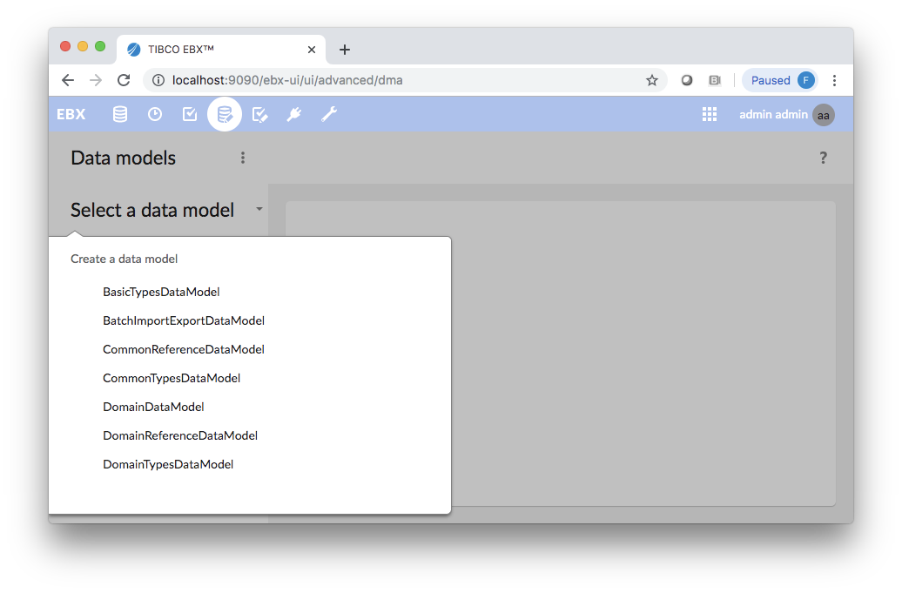
PS Starter Project Features
Pre-configured with Best Practices for Multi-Domain MDM Projects
Pre-populated Basic Types Data Model
Pre-defined Common Reference Data Model, Data Space, and Data Set
Sample Domain defined which can be used as a template

Slide 3
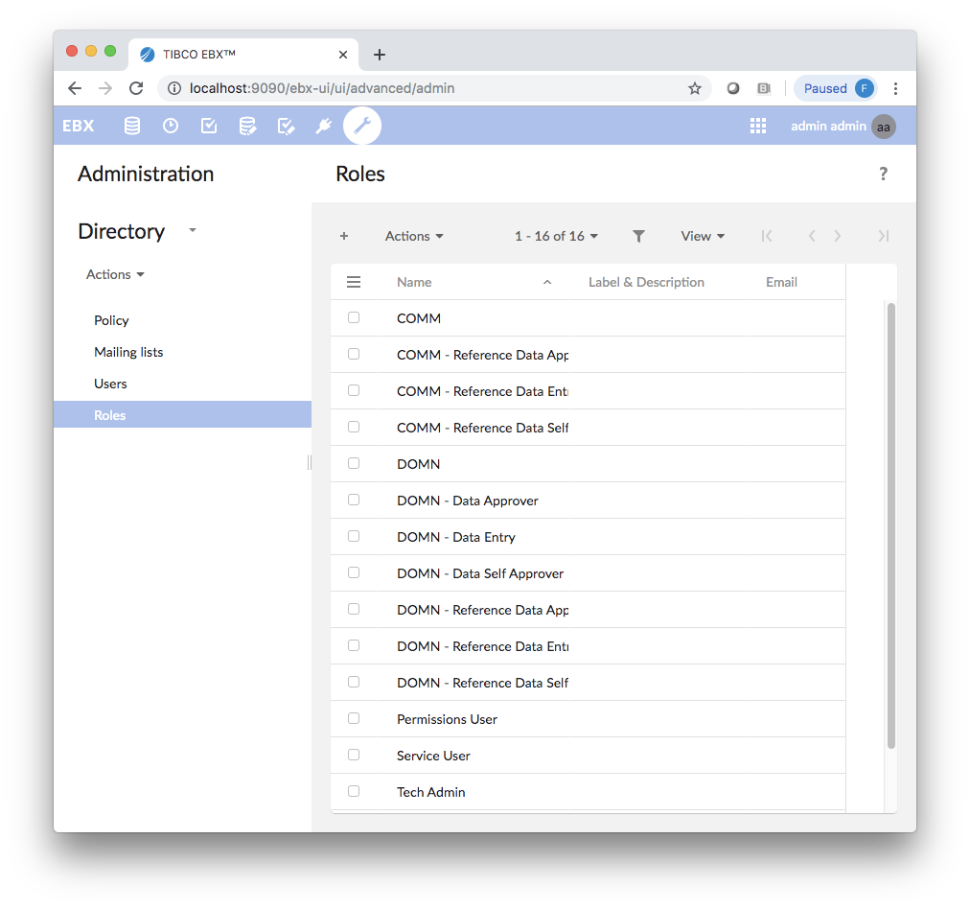
PS Starter Project Features
Pre-defined Standard Roles
Pre-defined Test Users for each Role

Slide 4
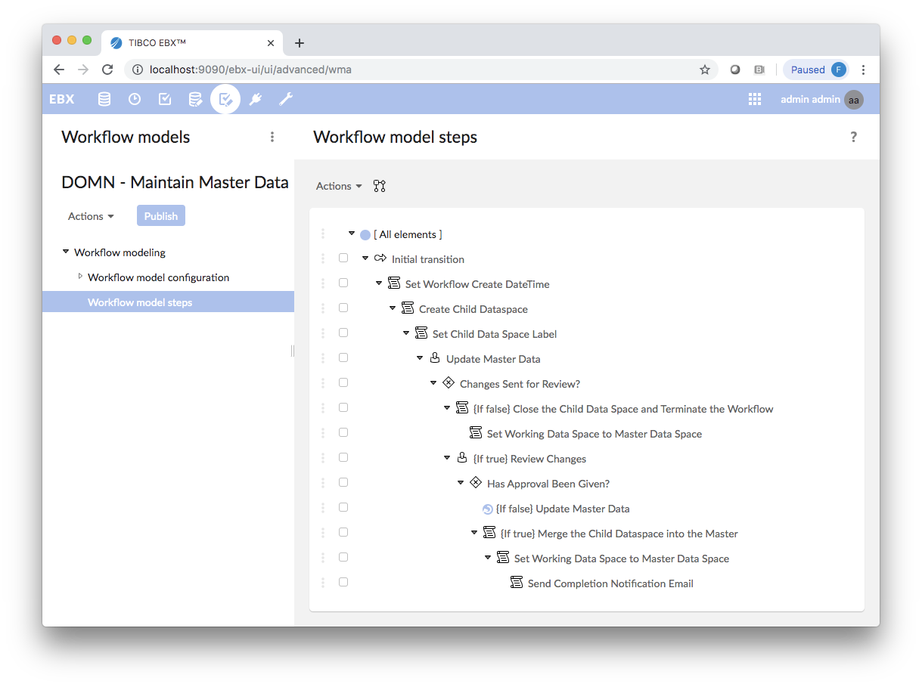
PS Starter Project Features
Fully Implemented Robust Maker-Checker Workflow for Common Model

Slide 5
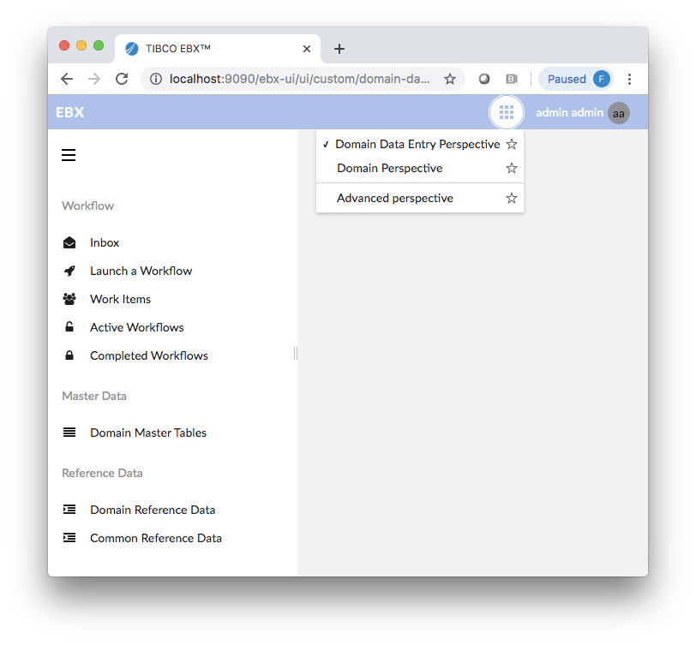
PS Starter Project Features
Pre-configured User Perspectives

Slide 6
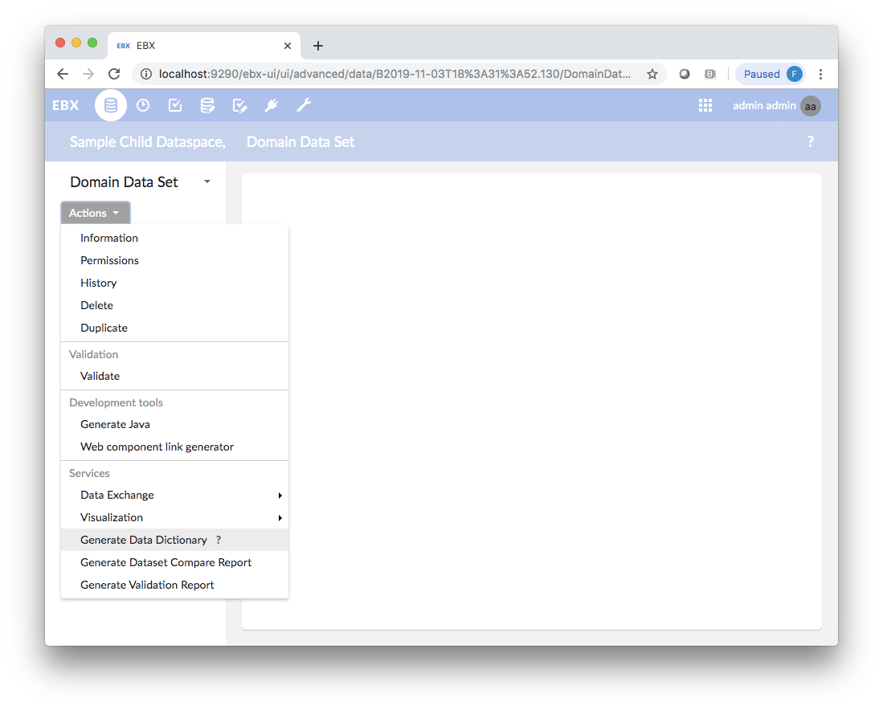
PS Starter Project Features
Pre-configured Services for Downloading and Displaying robust Full Validation Report
Pre-configured Service for generating Data Model Data Dictionary Spreadsheet
Pre-configured Service for generating downloadable Child Dataspace Compare Report Spreadsheet
Pre-configured Services for Import/Export Dev Artifacts
Pre-configured Services for Batch File Imports

Slide 7
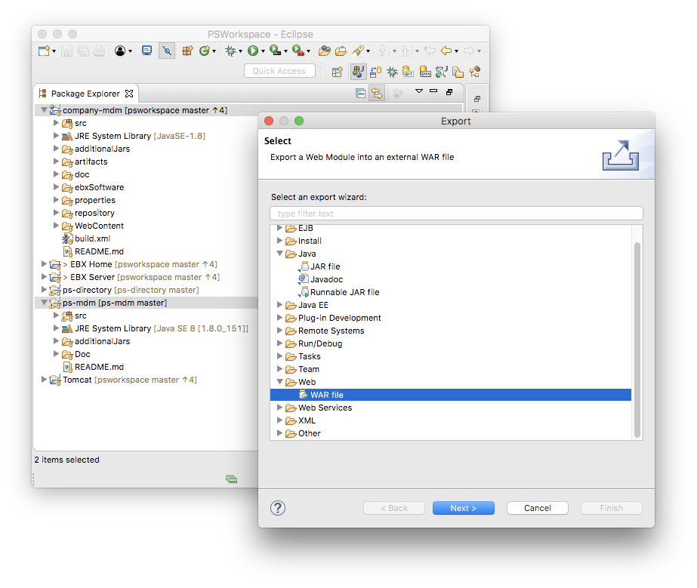
PS Starter Project Features
Organized to allow single click generation of Company-MDM War File and independent PS-Library JAR File

Slide 8
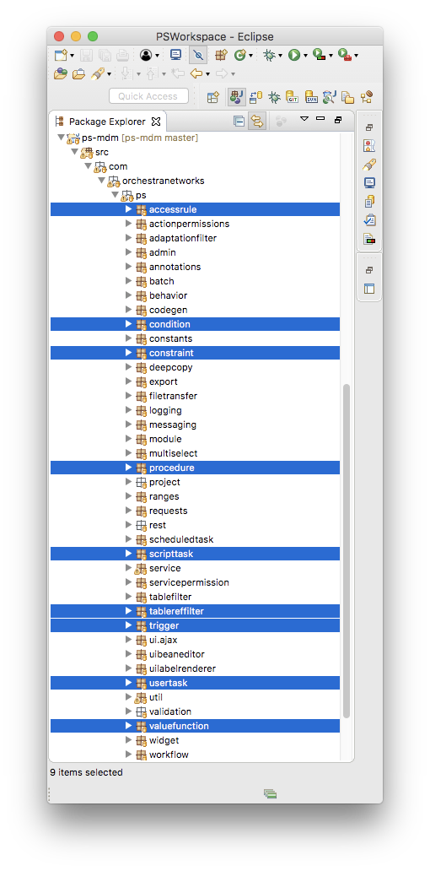
PS Framework Library Features
Import/Export Dev Artifacts
Workflow Features
Validation Rules Library
Access Rules Library
Value Functions Rules Library
Table Triggers Library
Project Framework Features
Additional Framework Features

Slide 9
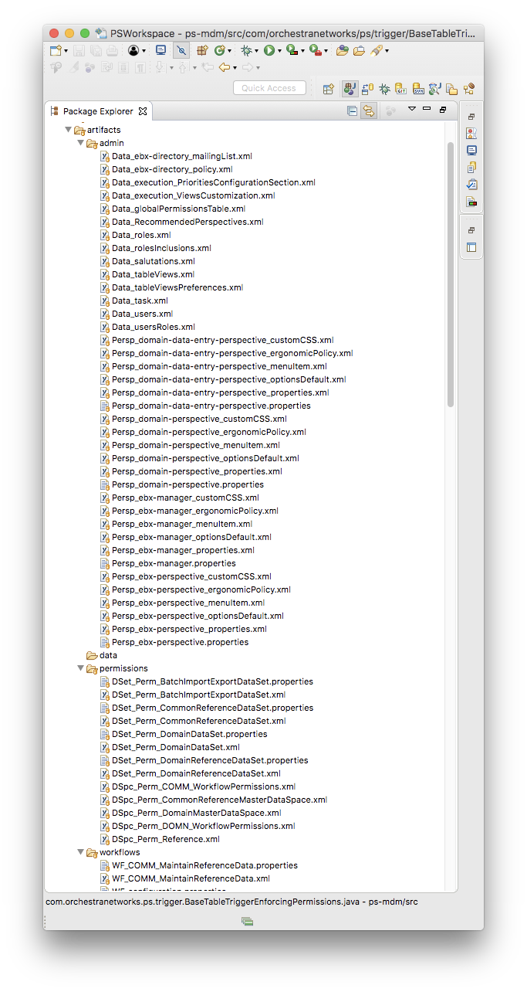
PS Framework Library Features
Import/Export Dev Artifacts
Manages Individual Workflow Models, Dataspace/Dataset/Global Permissions, Role Definitions, View Definitions, Perspectives, Add-on Configurations, and other Admin Settings
Allows Importing/Exporting of Development Artifacts
Eases ability to manage artifacts among multiple developers on a Project Team
Provides Granular Integration with Source Control systems
Allow for easy migration from Environment to Environment.
Provides XML-Based Diffs to review, merge, and/or make changes to Workflow Models, Dataset permissions, and other artifacts.
Also allows for Data in specified tables and datasets considered as “part of the solution” to be managed and migrated.
Automatically Publishes all workflows that have been changed

Slide 10
PS Framework Library Features
Import/Export Dev Artifacts Multi-tenant Mode
For multiple development teams (tenants) working independently yet sharing the same EBX instance.
Each tenant manages just the artifacts they own.
Each tenant configures its own properties file.
“Replace mode” only replaces artifacts owned by the tenant.
One set of Import/Export services per tenant rather than one set per overall EBX instance.
One tenant is identified as the “admin” tenant and is responsible for artifacts that must be shared across tenants.
Most artifacts are determined by the tenant’s module(s) or a tenant-specific prefix, but can be listed individually when needed.
Full support for multi-tenant mode in REST service and command-line interface.
Currently, all add-on data is managed by the “admin” tenant. Full multi-tenant support for add-ons will be addressed in future.

Slide 11
PS Framework Library Features
Workflow Features
Workflow Launcher: Provides Standard Workflow Launching Services based on Selecting an Individual Record or Creating a New Record.
Builds Workflow Label and Child Dataspace Label so Users can easily associate related Workflow instances and Child Dataspaces
Initialization of Standard Data Context Variables
Basic User Task, General Maintenance User Task, General Approver User Task
Manages dynamic assignment of users and roles to work items
Maintains data context variables such as current user and current record label
Provides Standard Work Item Exit Criteria Rules and formatting of error messages
Robust Standard Email Templates for Work Item Notification, Workflow Completion and Cancellation Notifications, and Work Item Reminders
Condition for checking Model-based Predicates
Condition for checking if Dataspace has changes at dataset, table, or record level
Script Task for Setting Values in the Data Model
Script Task for Validating Child vs. Current Master and routing back to User if Errors prior to merging

Slide 12
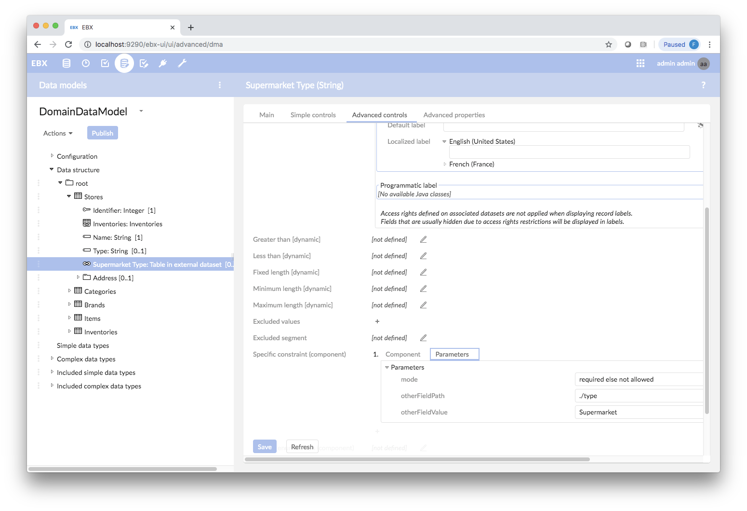
PS Framework Library Features
Validation Rules Library Highlights
Base Constraint On Table With Record Level Check: Simplifies writing constraints by providing an abstract “check value” method
Choice Constraint: similar to an XML Choice, allow for only one of set of attributes to be populated (and can require at least one).
Field Conditionally Required Constraint: Extends Constraint On Null to define one field as required (and/or not allowed) when another field has a certain value
Acyclic Constraint: Prevents cycles in data involving recursive parent/child relationships
Ranges Constraint: Prevents a set of ranges of dates or numerical values from having overlaps and/or gaps vs. other records sharing a common parent foreign key value
Collection Not Empty Constraint
Field Combination Not Allowed Constraint
Uniqueness On Filtered Table Constraint
Limit Field Value In Record Group Constraint
No Duplicates Constraint

Slide 13
PS Framework Library Features
Access Rules Library Highlights
Access Rule Manager: Manages Multiple Access Rules Defined on a Single Node. Will Apply Most Restrictive Rule
Workflow Access Rule: Allows a Permission Profile to be assigned to Individual Workflow Steps. Applied as a Restriction on the Current User’s Permissions.
Record Matches Access Rule: Prevents updating of Records that are outside the “Scope” of the Current Workflow
User Table Lookup Access Rule: Controls Access to individual Records based on a User Lookup Table (i.e. Controlling Access to records for a particular Country based on User Country Table)
Various Other Commonly Used Access Rules:
Hide On Create Access Rule
Read Write For New Record Only Access Rule
Read Write Until Value Assigned Access Rule
Hide When Record Matches Predicate Access Rule
Restrict Based On Session Attribute Access Rule

Slide 14
PS Framework Library Features
Value Functions Library Highlights
Foreign Table Attribute Value Function: looks up a field's value via a foreign key
Attribute Value List From Linked Record List Value Function: will return a List of the Attribute Values from a list of Linked Records
Field Collection Count Value Function: evaluates the paths as 'path expression' to produce a related collection and returns the size of that collection
Is Active Value Function: Determines if a record is active based on start and end dates, allowing for nulls
Oldest Or Newest Date Value Function: will return either the oldest of newest date value from a collection (controlled via parameter)
Various Other Commonly Used Value Functions:
Is Empty Value Function
Is Future Value Function
Create Date Time, Creator User, Last Update Date Time, & Last Update User Value Functions

Slide 15
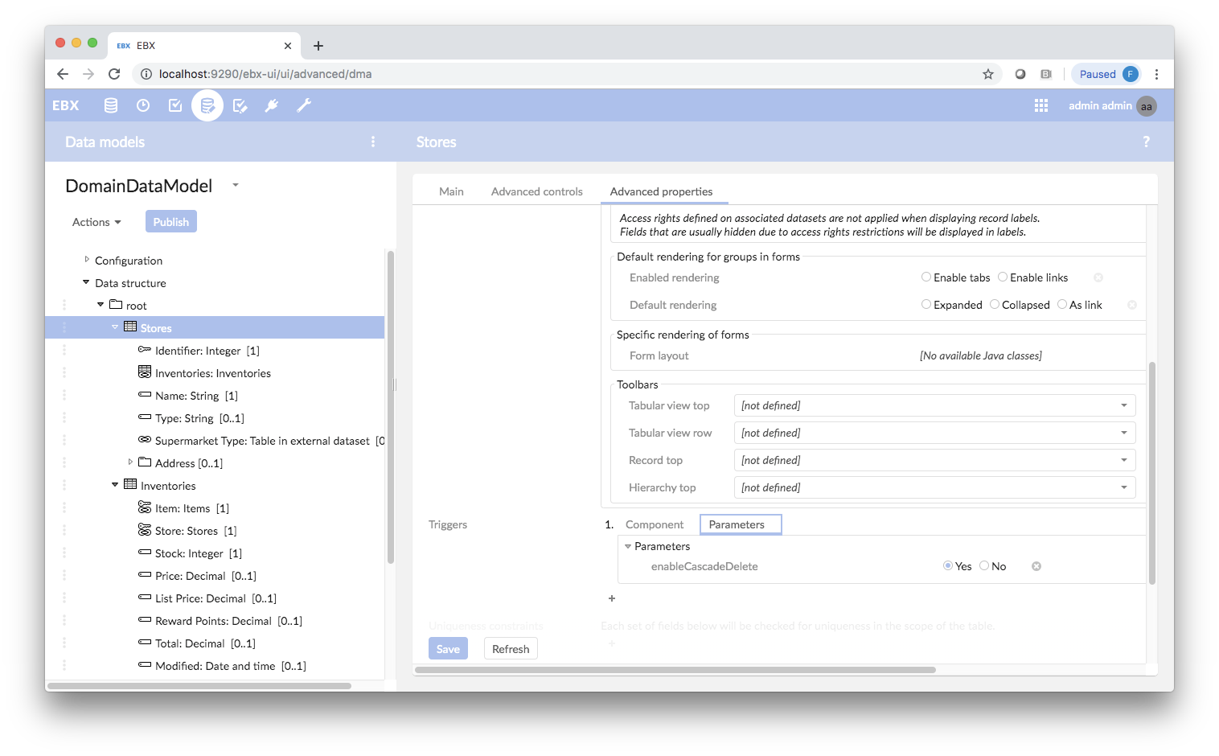
PS Framework Library Features
Table Triggers Library Highlights
Base Table Trigger: Implements Cascade Delete features and validation of Create, Update, and Delete operations
Current Date Default Table Trigger: Attach to a date field to have it default to current date.
Convert To Upper Case Table Trigger: Attach to a string field to convert values to uppercase.
Fix Sort Order Table Trigger: Manages a sort order field within a collection when records are created, updated, and deleted
Reset Inherited Fields Table Trigger: Prevents inherited fields from being overridden

Slide 16
PS Framework Library Features
Project Framework Features
Provides Abstract Table Definitions to define standard Project entities (via Path Config Pattern):
Project Table, Subject Table, Project Team Members Table, Project Workflow Events Table
Workflow Launcher Extensions for launching Projects to create new Subject Instances, perform updates or other tasks on existing Subjects, or resume work on suspended projects.
Project and Subject Table Triggers to assign Project Type, Project Name, Project Team Members, Link Subject(s) to Project, control Project and Subject Status
Also managed thru various Script Tasks, Foreign Key filters, UI Beans and Service Permissions
Provides Access Rules and Triggers to prevent updating of records outside the scope of the Project
Workflow Permissions based on Project Team Members
Prevents launching of conflicting Projects for a given Subject Record

Slide 17
PS Framework Library Features
Additional Framework Features
Restricted Enumeration UI Bean Editor
Service to perform Deep Copy of a Record and all its logical child records
Auto Increment Number Generator
Standard Create, Modify, and Delete Procedures
LDAP Directory Integration
Standard Adaptation Utilities Library
Batch Import Facility
Scheduled Task for purging old closed Child Dataspaces

